Slide 1
Opencv Tasks

Slide 2
Image Task
Create a window for dragging and dropping an image.
Try to apply all the filters and geometric transformations that we covered in the Opencv lab to the image that you have selected.
Use the images in the next slide as a guide for the task (you have to use tkinter + opencv).

Slide 3
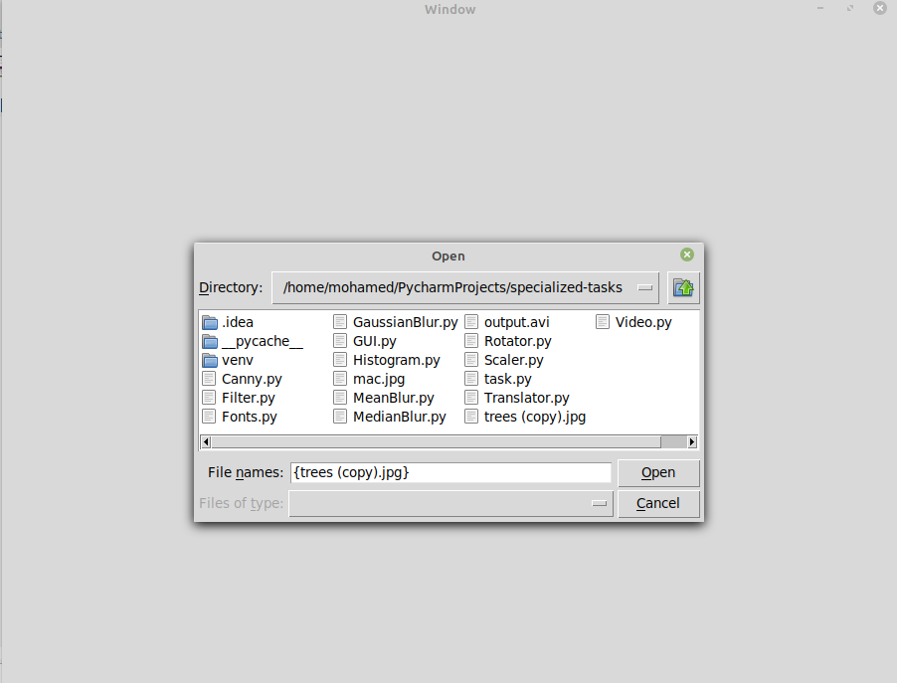
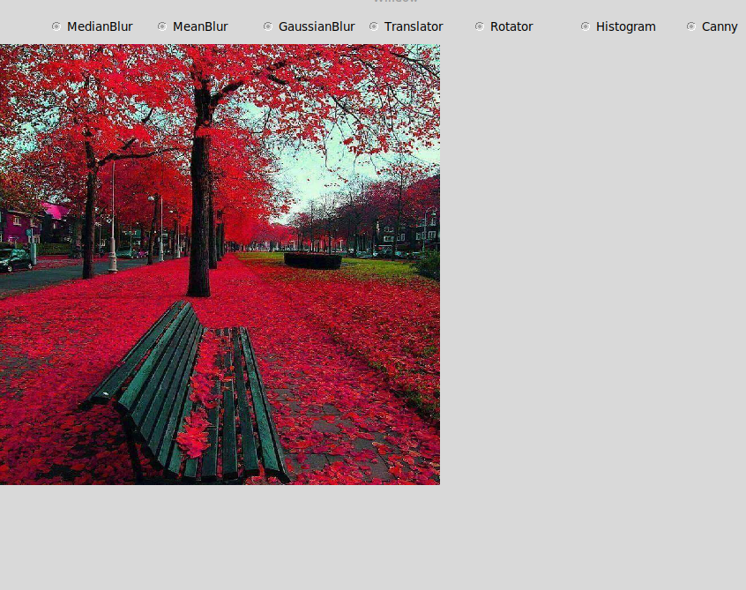
Image Task continued

Slide 4
Note
I have added a python file with the name taskhelpers.py to help you with creating some things but it’s not the complete code for the task you have to use some things in the opencv lab and google some other things. The task requires using both tkinter & opencv.

